Slide 1
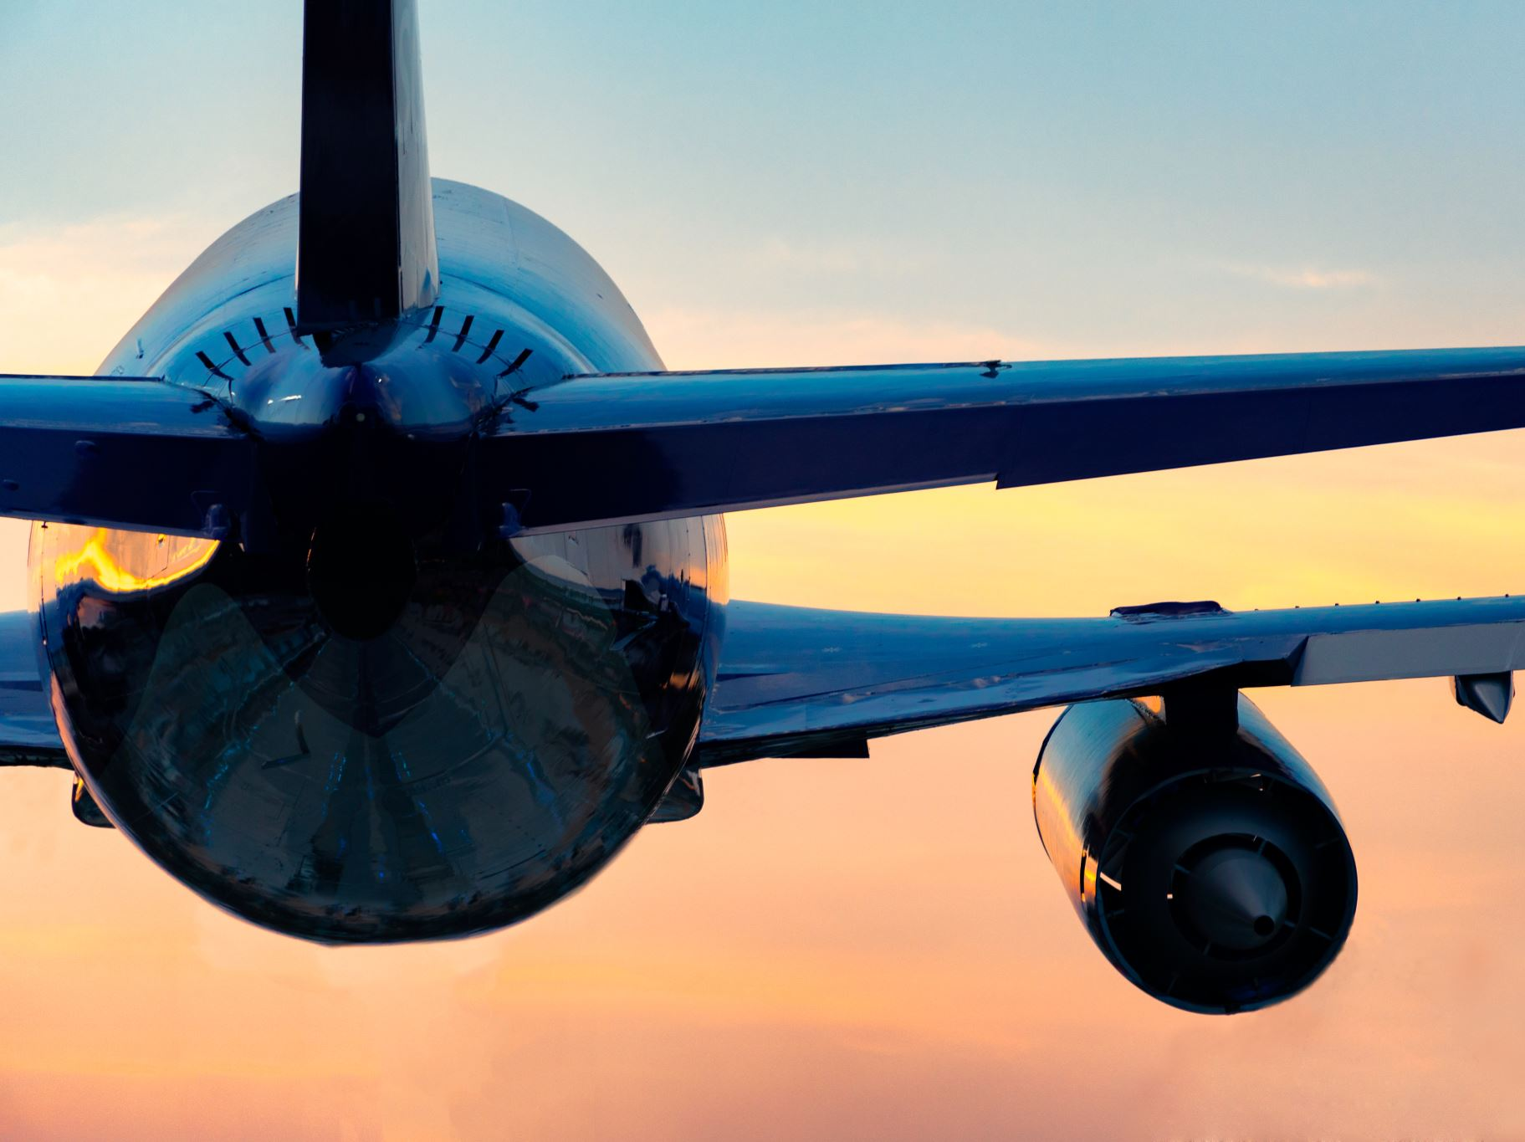

Is Air travel the safest form of Transportation?
-Ramizuddin Mohammed Shabuddin

Slide 2
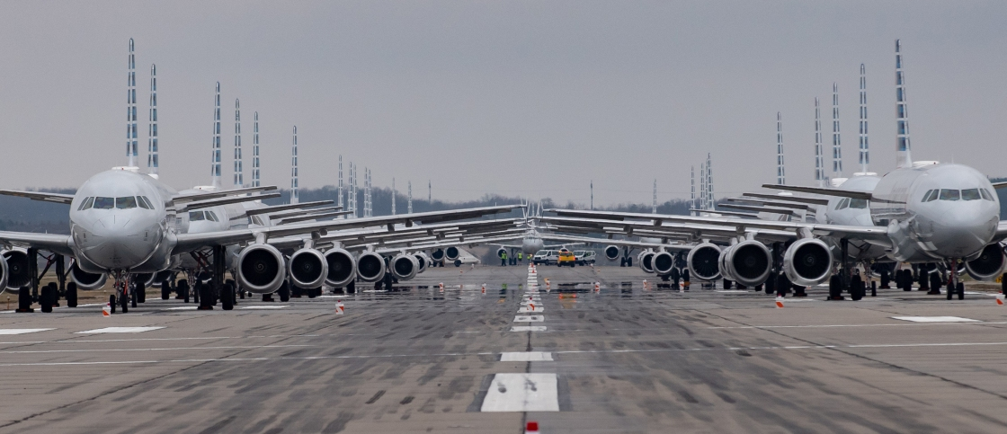
45,000 Average daily flights handled.
5,400 Aircrafts in the sky at peak operation times

Slide 3
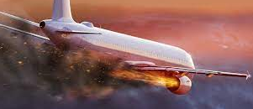
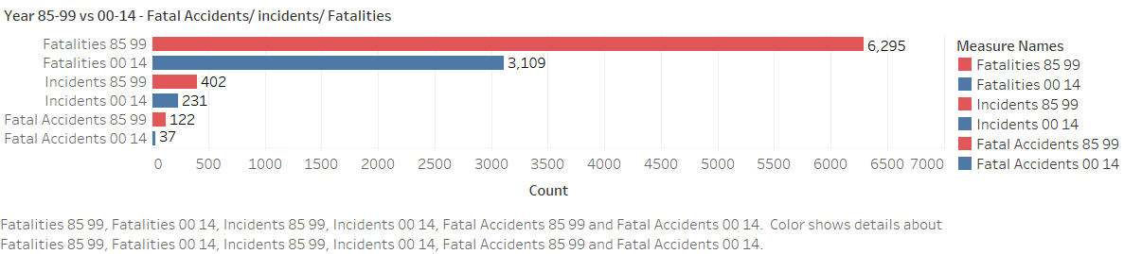
Year 85-99 vs 00-14 - Fatal Accidents/ incidents/ Fatalities
The Fatal Accidents, Incidents and Fatalities has decreased drastically over the years.
50.61% Reduction in Fatalities
42.53% Reduction in Incidents
69.67% Reduction in Fatal Accidents.

Slide 4
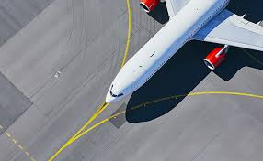
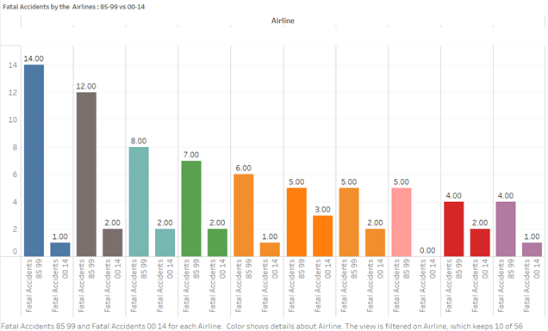
Fatal Accidents by the Airlines : 85-99 vs 00-14
All the airlines with most fatal accidents in the years 1985-1999 has reduced number of fatal accidents in the year 2000-2014.

Slide 5
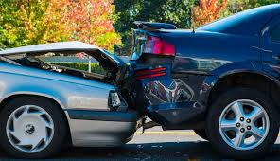
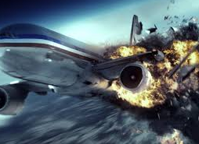
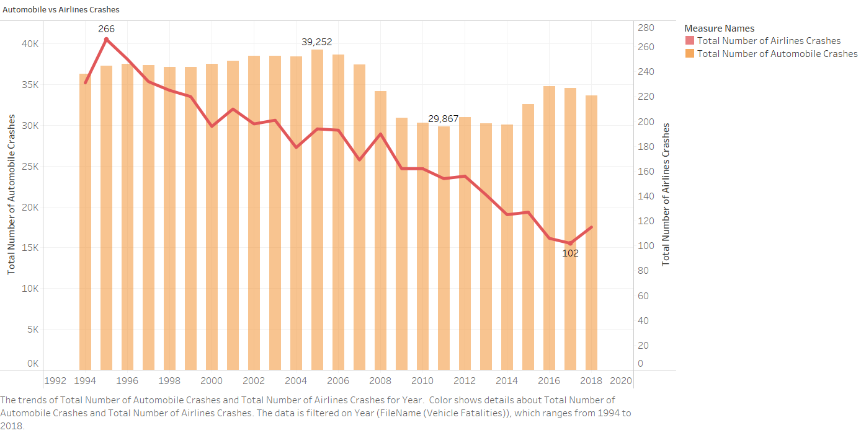
Automobile vs Airlines Crashes
Automobile crashes are in 30K vs airline crashes are 300

Slide 6
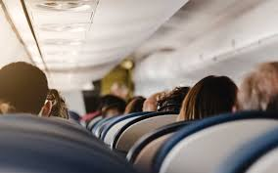
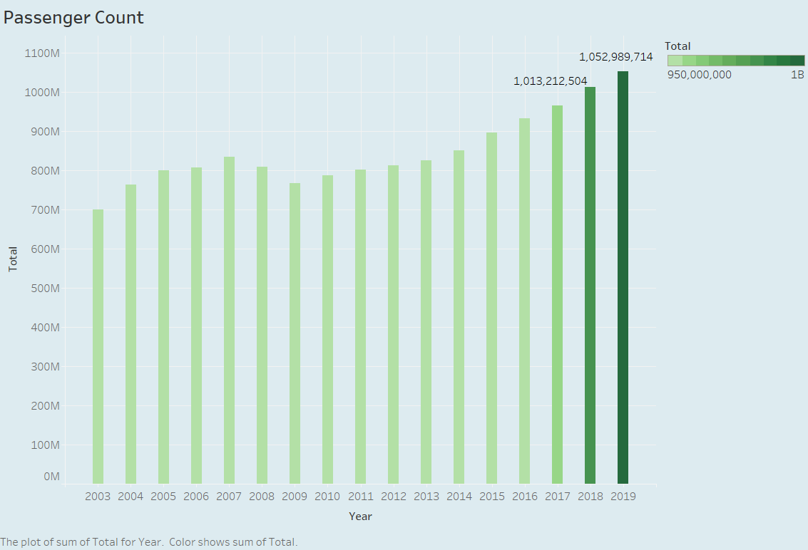
Passenger count over the years
The number of passengers have cross 1000M from 2018. Indicating people prefer airlines

Slide 7

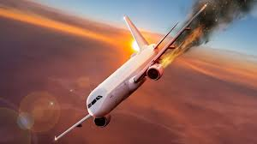
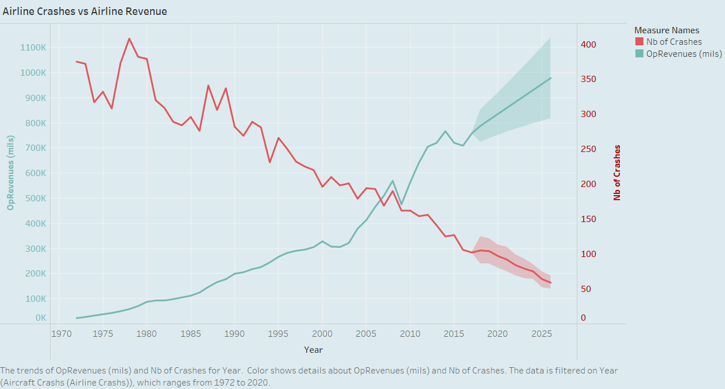
OpRevenues(mils) is expected to cross 900K (mils) in coming years.
Number of Crashes has reduced lesser than 100

Slide 8
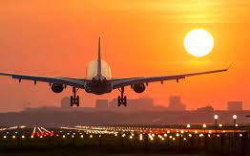
Thank you!! Have a safe journey

